Slide 1

Program Interface

Slide 2


Slide 3

Program Executions

Slide 4

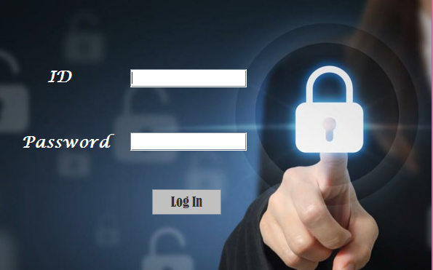
Login Form
When you login as an admin you are transported to the portal page which makes you choose between some choices like controlling Students data , Grades
Or Courses

Slide 5
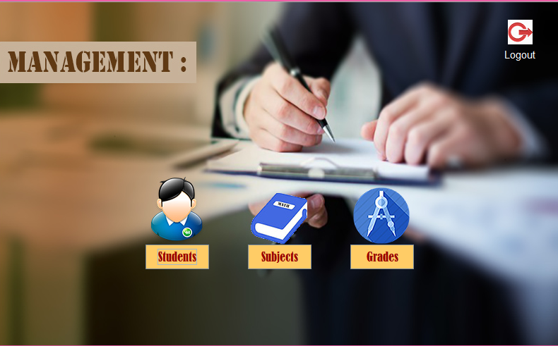
Main UX Form the main form contain
Each section
Students
Grades
Subjects

Slide 6
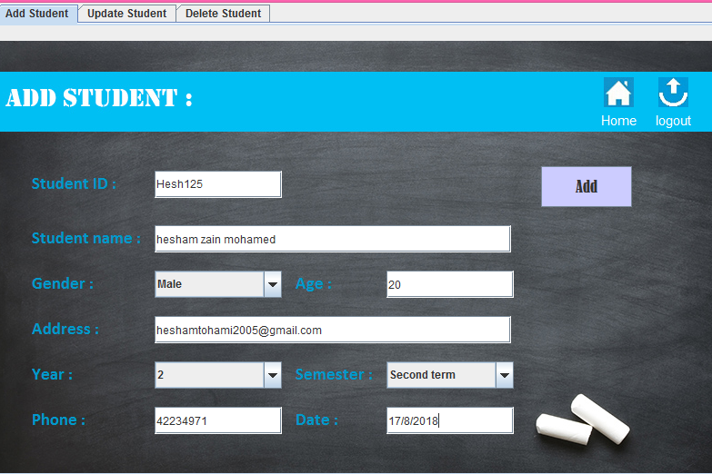
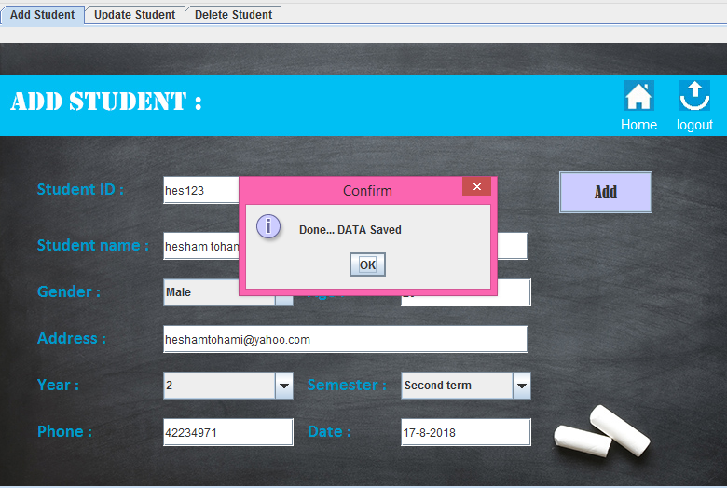
Student
When user tried to enter data for student , should fill all the data fields
And by clicking “add” , data saved message appear on screen
Which refer that data saved successfully in the database .

Slide 7
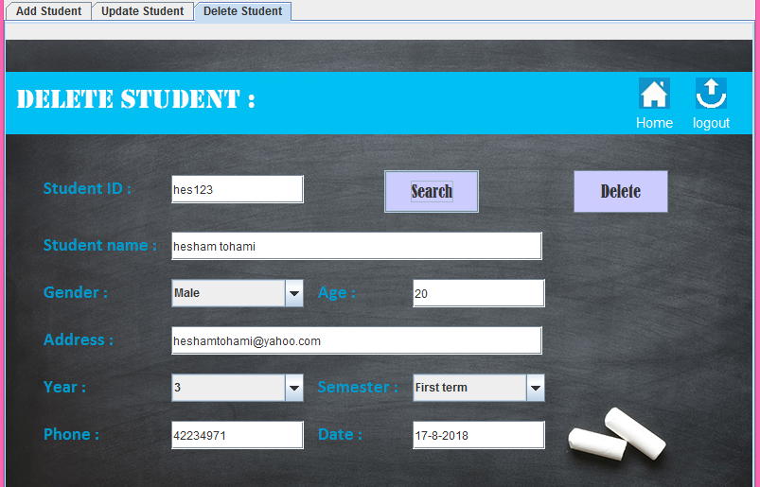
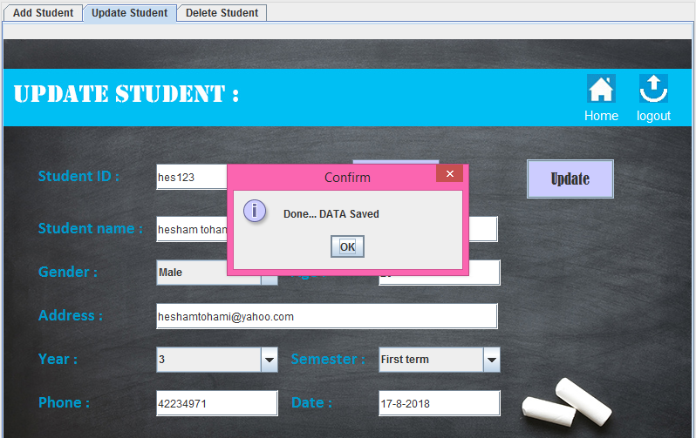
Update happened when user try to change any of student’s data by write it’s id and try
To edit any of them and click update , when message update done appear we find data updated at the database .
We can also by the last way delete the contain of the student

Slide 8
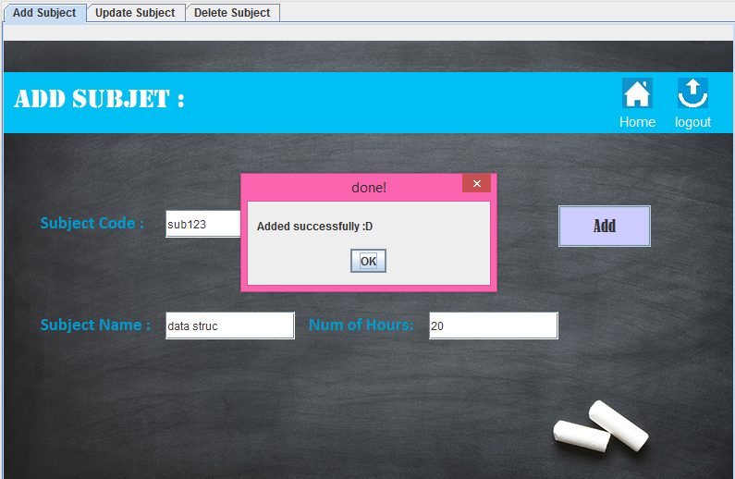
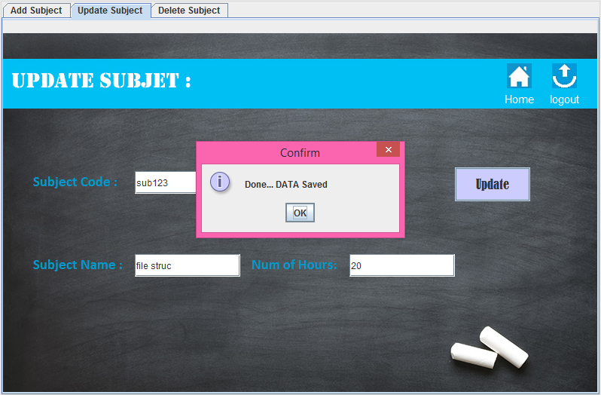
Subject section work done by adding id of student and the course in addition it’s name and click add.
We can also update and delete data by using ids and click update or search

Slide 9
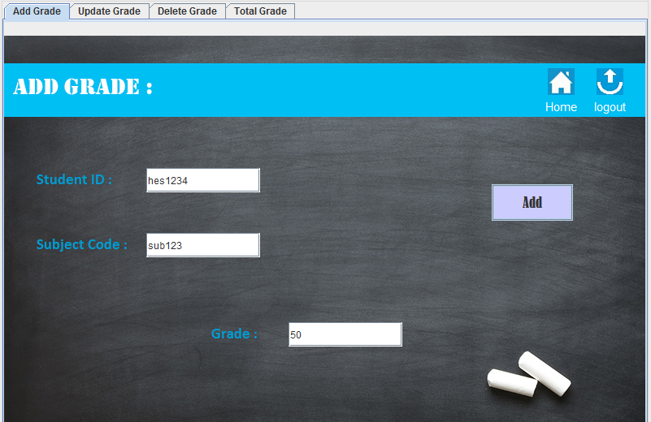
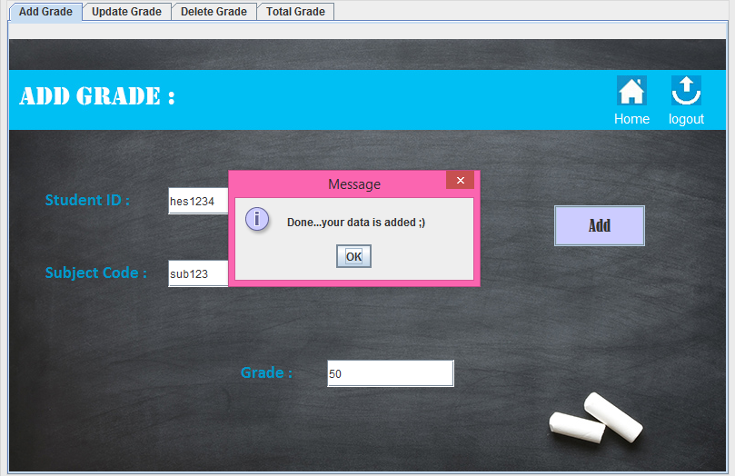
By adding id of student and the course
We can add the total grade of students by this way and so…on .

Slide 10
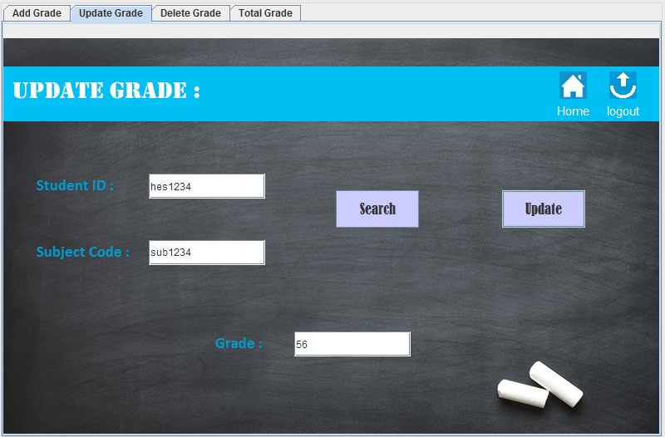
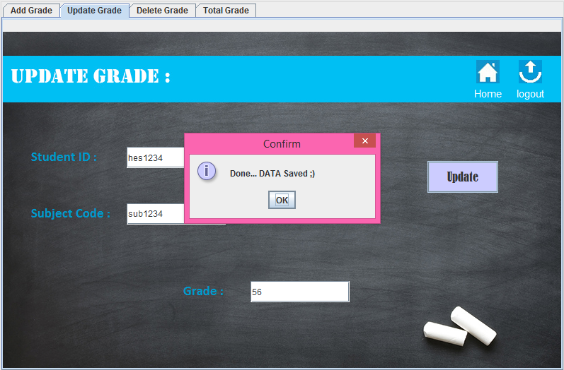
Grade
Updating total grade by the same way of this sections

Slide 11
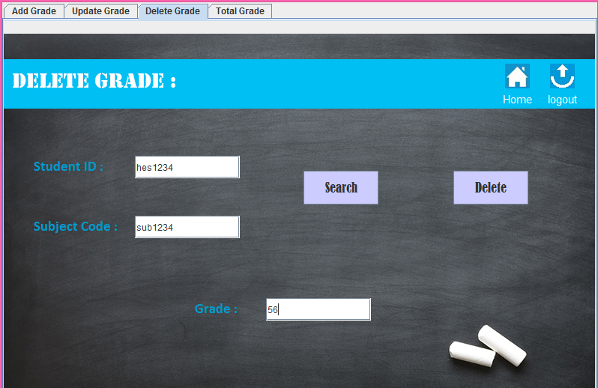
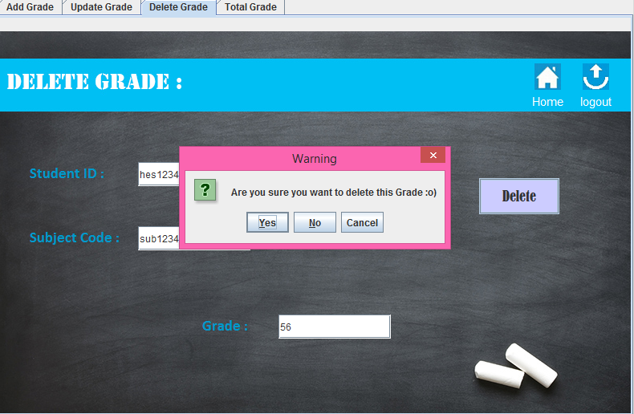
Deleting this data also by the same way of last sections
In student and subjects

Slide 12
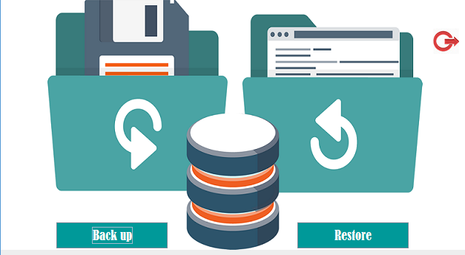
Make Collection Of data used in a file used
To save data from my sql to the maschine

Slide 13
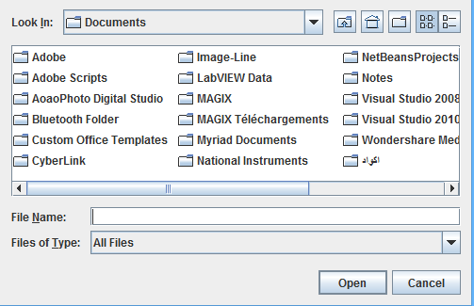
Restore the contain of data backup file to the data base
In case of lost the data and we want patiently .

Slide 14


Improvements

Slide 15
01
Converting DB to Oracle on Server
02
Making a Website for the Solution
03
Making a Mobile app for the Hospital
04
Connecting all PC’s on the
Server as intranet.
05
Making GPS on the Mobile app to guide people inside the hospital

Slide 16

Difficulties Encountered

Slide 17

We aren’t from the same Distinction.
Not having the required experience.
The time is a little bit small.

Slide 18


